Slide 1
Information Density and Data Ink
Notes:
Another feature of great visualizations: they are information dense.

Slide 2
Information Density
  Graphical displays should present many numbers in a small space
Tufte, 1983
Notes:
Information density is the idea that graphics should present a lot of information in a small space.
You can think of this as a kind of efficiency.

Slide 3
Why Information Dense Plots?
Space is limited
Viewers have limited attention
You want your graphics to provide evidence for your analysis
You want layers of detail for readers to explore
Notes:
Why information dense plots?
You have a page limit – or a time limit
More importantly, viewers have limited attention. They don’t want to flip through dozens of graphics.
For some purposes, you might only keep your audience for 2 or 3 plots, so you can’t waste any of them.
You want your graphics to support your analysis, which means they have to provide a lot of evidence.
Maybe you want rich graphics that draw your reader in to explore. At first they may notice major features that are central to your analysis. Ideally, as the viewer keeps exploring, they notice new details and keep learning about the data.

Slide 4
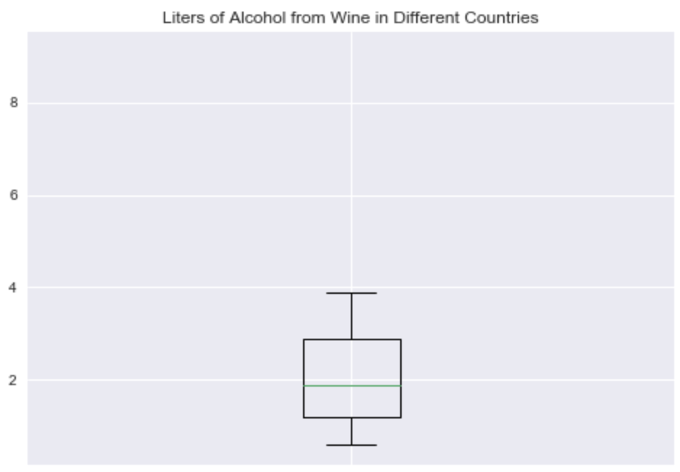
Notes:
Here’s an example of a boxplot, showing the distribution of 1 variable.
Boxplots can be a great tool when you’re comparing different groups against each other. You can immediately see which has a higher median, which group is more dispersed, and so forth.
In this case, however, there is only one variable, and there are only a few values you can extract from this plot. the boxplot doesn’t have good information density.

Slide 5
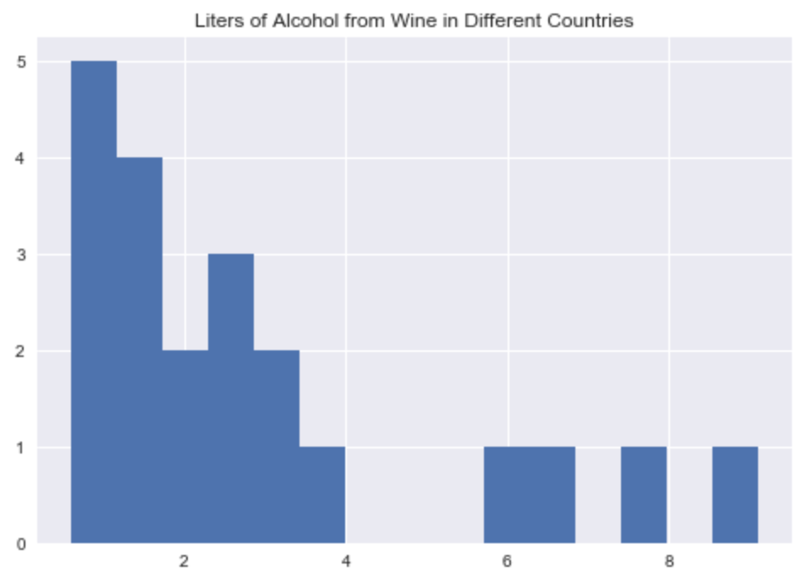
Notes:
Instead, you can try a histogram, which uses the same space, but lets you see details about the shape of the distribution.
If your purpose is to give the reader an overall impression of the distribution, the histogram is a better choice.
In this case, we improved the information density by keeping the space constant, and increasing the information content. But sometimes you can keep the information the same, and reduce the space.

Slide 6
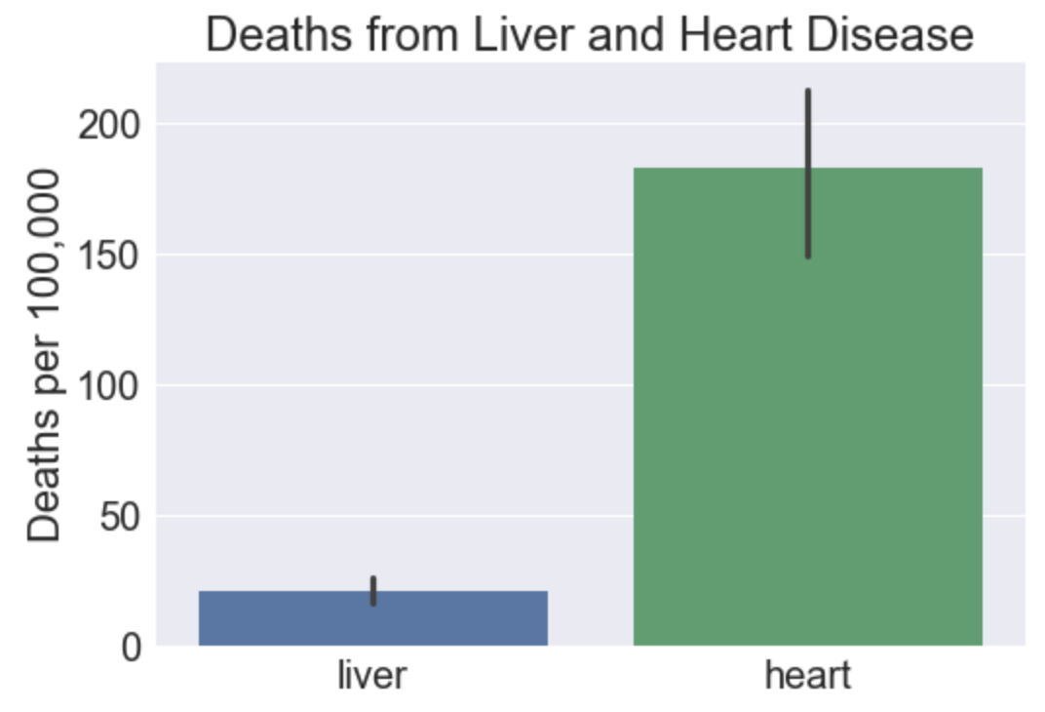
Presenting Data Efficiently
Table 1. Deaths per 100,000
… Deaths from heart disease were estimated at 183 per 100,000 (std. err. = 16) compared with 21 per 100,000 for liver disease (std. err. = 3)…

Slide 7
Respect Reader Attention
Attention is needed for key data features
Other drains on attention:
  Nonessential data features
  Features caused by noise
  Legend navigation
  Matching position to axes
  Abbreviations
Notes:
So far, we’ve looked at information density with space in the denominator, but space is really just one aspect of information efficiency.
It’s often even more important to think about your reader’s attention.

Slide 8
Data-Ink
  A large share of the ink on a graphic should present data-information, the ink changing as the data change. Data-ink is the non-erasable core of a graphic, the non-redundant ink arranged in response to variation in the numbers represented.
  -Tufte, 1983
Notes:
One idea that can help guide reader’s attention is data-ink

Slide 9
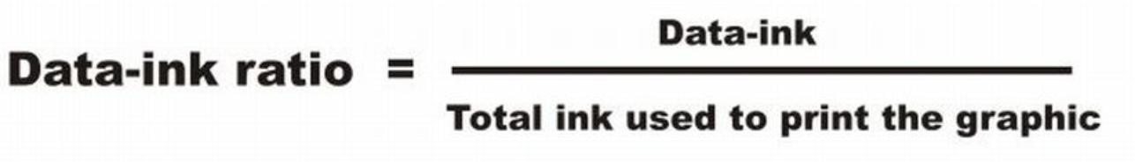
Data-Ink

Slide 10
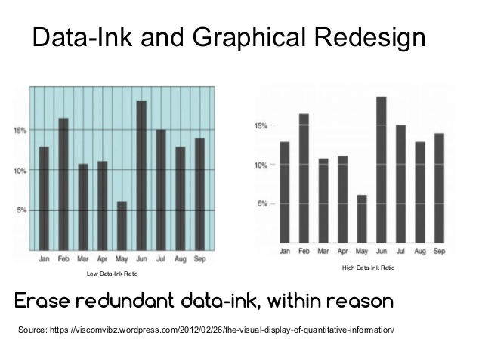
Maximizing Data-Ink

Slide 11
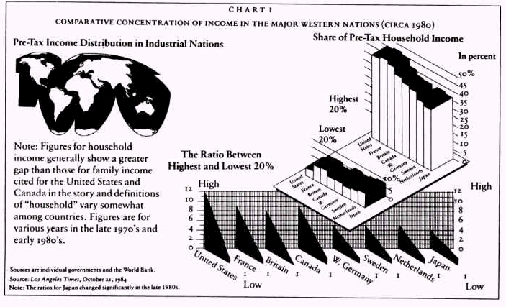
Avoid Chart Junk
Notes:
One more corrollary to the data-ink rule: Avoid chart junk.
Chart Junk: Unnecessary icons, 3D effects, shadows, and other distracting additions that don’t add information.
You don’t have to be entirely minimalist, but avoid elements that are clearly junk.

Slide 12
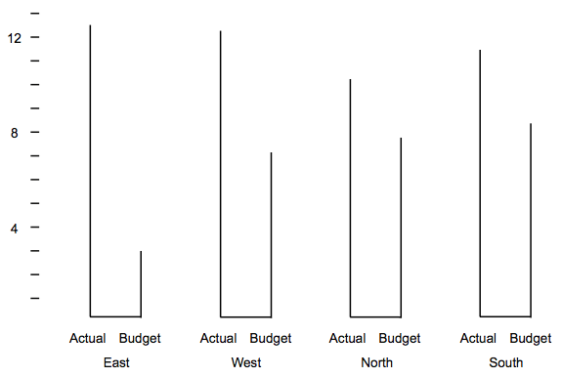
Too Little Ink?

Slide 13
Integrate Graphics with Analysis
Graphics should be used purposefully, in the context of a logical argument.
No output dumps!
Notes:
Finally, part of getting the most out of your plots, is integrating them with your text analysis.
If you put a plot in and don’t mention it in your text, it’s going to get lost. This is what we call an output dump.
This is very important: No output dumps!
The text must provide the context, explaining how the graphic relates to the overall analysis.
You’re creating an argument – it has to flow coherently and guide the reader in interpreting the plots.

